Slide 1
MBTA Communities Act Overview and Impact on Southborough
Consolidated by: Southborough Planning Board
MAY 2024

Slide 2
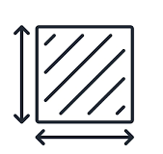




What is the MBTA Communities Act?
State zoning law to boost multi-family housing development near transit stops
In 2020, the Zoning Act was amended by Massachusetts Legislature to promote the production of multifamily housing within walking distance of public transportation to address the severe regional housing shortage
The New Law: “M.G.L. c. 40A § 3A (a)(1) An MBTA Community shall have a zoning ordinance or by-law that provides for at least one district of a reasonable size in which multi-family housing is permitted as of right…”
Commuter rail community — served by the MBTA commuter rail; must rezone to permit a minimum number of multifamily housing units equal to 15 percent of the current housing stock.
50 total acres: 10 acres within ½ mile of MBTA station
Walking distance to public transportation, bikeways, bus stops
Suitable for families with children (no bedroom or age restrictions)
Zoning must allow a minimum gross density of 15 units per acre
Zoning permit process cannot be discretionary
For additional information visit: https://www.mass.gov/info-details/multi-family-zoning-requirement-for-mbta-communities#complying-with-section-3a-guidelines-

Slide 3
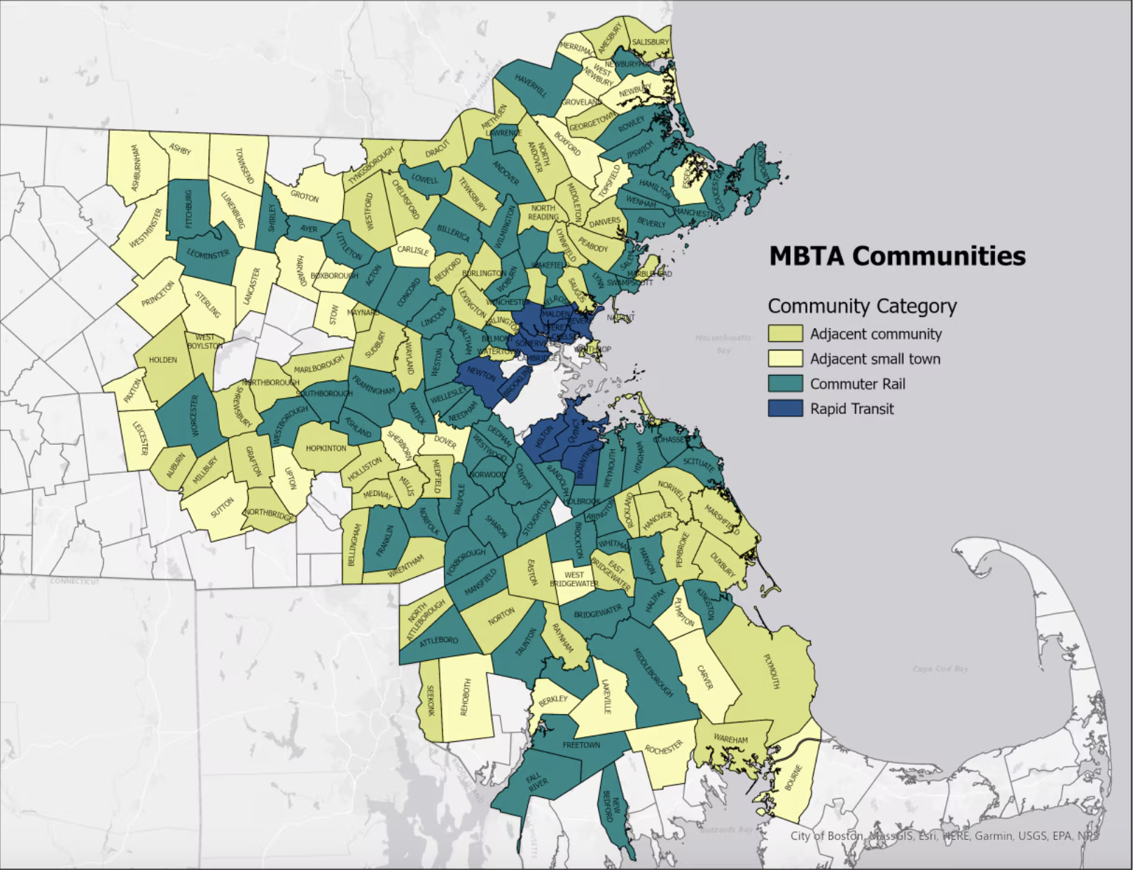
What are the MBTA Communities?
177 communities in totality; with four (4) types of communities designated
Rapid Transit Communities – Fourteen (14) Greater Boston cities and towns, that initially hosted MBTA service, must submit their district compliance applications by December 31, 2023.
Community Rail Communities – Fifty-one (51) communities that also host MBTA service but joined later) must submit their district compliance application by December 31, 2024.
Adjacent Communities – Must submit their district compliance application by December 31, 2024
Adjacent Small Towns – Must submit their district compliance application by December 31, 2025.

Slide 4
What the Act Means to Southborough
As a commuter rail community, Southborough has a moderate level of obligation
“The new policy is not a construction mandate, but a mandate for zoning allowances that can offer expanded opportunities to build homes. No municipality would be forced to build units on any specific timeline — or even build them at all.”
– Boston Globe
1.69"
10 Acres within 1/2 mile of the MBTA station
25 Acres must be contiguous
15 Acres in minimum of 3, 5 Acre areas
750 Units
Rezone to permit 750* multifamily housing units
20% required near transit stations
Source: https://www.bostonglobe.com/2022/07/13/metro/is-states-multi-family-zoning-requirement-mbta-communities-good-policy/?p1=BGSearch_Advanced_Results
* This figure represents not how much new multifamily housing is likely to be built, but how many total units must be possible in the rezoned areas.
Notes:
Commuter rail community — served by the MBTA commuter rail; must rezone to permit a minimum number of multifamily housing units equal to 15 percent of the current housing stock. Deadline for rezoning is the end of 2024.
Population (2020): 10,450 Housing units (2020): 3,763 Owner-occupied percentage: 90.7% Median household income: $156,845

Slide 5
Zoning Overlay with Local Controls
Allows “as of right” development that must be compliant with Planning Board site Plan Oversight
“As of Right”
means development that may proceed under a zoning ordinance or by-law without the need for a special permit, variance, zoning amendment, waiver, or other discretionary zoning approval
Site Plan Review application
Public hearing with abutter notification for projects >2000 Square feet (SF)
Heights, setbacks, parking, lighting, and Lower Impact Development must meet local Southborough requirements
10% units required to be inclusionary dwellings for Southborough Housing Inventory (SHI)
90% units are market rate

Slide 6
What Happens if Southborough Votes Down?
Compliance with the law is mandatory; Voting “No” could come with a cost
An MBTA community that fails to comply with this section shall not be eligible for funds from:
The Housing Choice Initiative
The Local Capital Projects Fund established in section 2EEEE of chapter 29; or
The MassWorks infrastructure program established in section 63 of chapter 23A
Potential Costs
Lose access to certain state grants Potential threat of legal action from AG Eminent Domain

Slide 7
Current Status on MBTA Bylaw Compliance
61 municipalities have approved bylaw and 12 towns have failed to pass
Municipalities where zoning for MBTA communities has passed (61)
Municipalities where zoning for MBTA Communities has not passed (12)
Abington
Acton
Andover
Arlington
Auburn
Bedford
Braintree
Bridgewater
Brookline
Cambridge
Canton
Chelsea
Chelmsford
Concord
Danvers
Dedham
Essex
Everett
Grafton
Harvard
Haverhill
Hingham
Hull
Lexington
Lincoln
Littleton
Lowell
Malden
Medfield
Medford
Newbury
Newton
North Andover
Northborough
Northbridge
Norwood
Pembroke
Plymouth
Quincy
Revere
Rockland
Rockport
Salem
Scituate
Sharon
Somerville
Stoneham
Sudbury
Taunton
Topsfield
Tyngsborough
Walpole
Wareham
Wayland
Wellesley
Westborough
Westford
Westwood
Weymouth
Whitman
Winchester
Hanson
Hopkinton
Foxborough
Marblehead
Marshfield
Middleton
Milton
Norwell
Rowley
Seekonk
Tewksbury
Wakefield

Slide 8
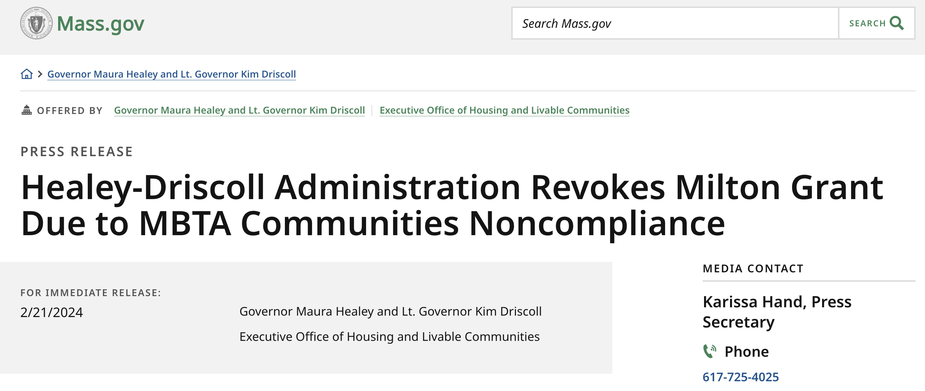
What Happens if Southborough Votes Down?
Ask the Town of Milton – 1st Non-Compliant Rapid Transit Community
To date, every other town has complied
Rapid transit communities date for Town approval was March 31, 2023: 11 of 12 communities have accepted bylaw
177 towns are impacted by bylaw, excluding Boston
Milton ramifications
$140,800 Seaport Economic Council grant revoked
Not eligible for Community One Stop grants
Not eligible for the 13 discretionary grant programs offered by the Executive Office of Housing and Livable Communities (EOHLC)

Slide 9
Planning Board Process to March Town Meeting
Intensive Education and Outreach Since August 2023 to enable compliance by December 2024
July 23
Overview of MBTA-multi-family zoning presented at Planning Board meeting
Aug 23
Public information with initial Postcard sent town-wide
Sep 23
Information Session #1 and #2 (Presentation and Q&A with state consultants
Oct 23
Designed & scheduled two mapping workshops- outreach to community
Nov 23
Two mapping workshops held on the 1st and 8th
5-acre stickers placed by residents where they felt the new multi-family zoning should be located
Dec 23
PB Members proposals for criteria and districts to consider
Jan 24
Compliance model run and MBTA Bylaw drafted to share in public meetings in February
Mar
24
Feb 24
Town Meeting Approval Deadline
Public Hearing start February 26, 2024
For additional information visit: Our Town Website: Planning Board: MBTA Communities

Slide 10
Planning Board Approach for Overlay Bylaw
Planning Board leveraged state consultants and additional tools to identify areas for re-zoning
Objective: Meet zoning act requirements while limiting impact to existing residential neighborhoods
Approach: Used state consultants and guidelines, resident mappings, and a rubric.
State Guidelines
Visit Planning Board on Town website
State information sessions held at safety building: 9/21 and 9/27 2023
Eligible Properties in Acreage
Privately owned properties Developable public land
Mapping Sessions held at senior center:
11/1 and
Non-Eligible Properties in Acreage
Conservation Land Non-profit owned properties Water Chapter 91 protected properties
Planning Board Rubric sessions held in public hearings
Notes:
Community mapping, applied rubric with scoring to get to three areas to meet requirements while last amount of impact to residential neighborhoods
While reducing impact to open space

Slide 11
Planning Board Approach for Overlay Bylaw
Planning Board rubric results
Notes:
Community mapping, applied rubric with scoring to get to three areas to meet requirements while last amount of impact to residential neighborhoods
While reducing impact to open space

Slide 12
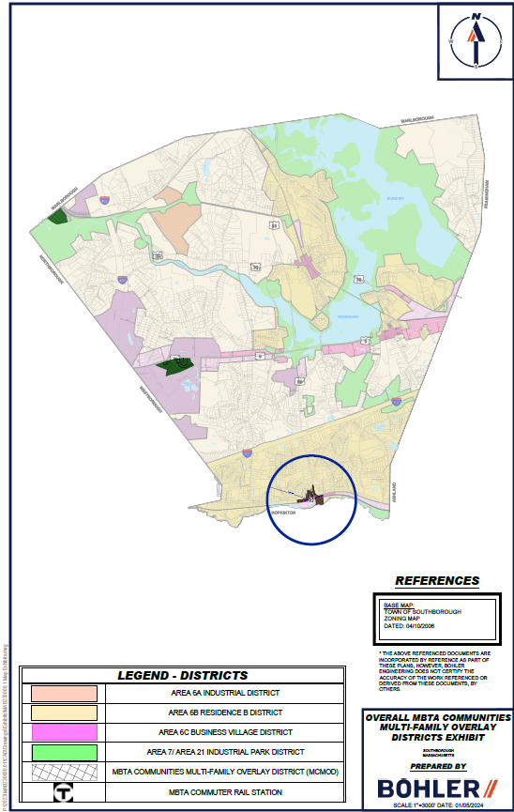
ORIGINAL Proposed MBTA Overlay Bylaw For Town Vote in March 2024
Recommended proposal meets
State Compliance Model
933 total units of the required 750
55.0 acres of the required 50
11.3 acres within the station area of the required 10
AREA #2: 34 St. Martin
AREA #3: Madison Place
AREA #1: MBTA Station

Slide 13
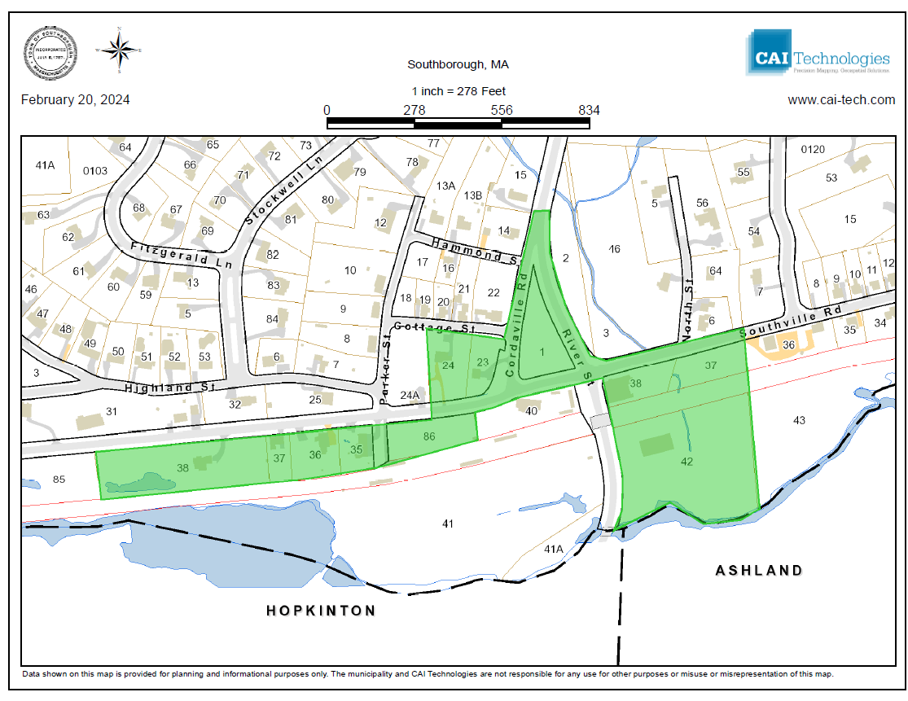
Area #1: MBTA Station
MAP/LOT | STREET | ACREAGE
4-1 | Cordaville | 0.74
4-3 | Southville | 0.55
4-2 | River St | 0.83
4-37 | Southville | 0.55
4-38 | 106 Southville | 0.54
4-42 | 10 River St | 3.49
3-35 | 114 Southville | 0.32
3-86 | 9 Southville | 0.91
3-36 | 116 Southville | 0.46
3-37 | 118 Southville | 0.25
3-38 | 122 Southville | 1.79
3-24 | 91 Southville | 0.63
3-23 | 279 Cordaville | 0.50
 | Total | 11.56
Southville Road
10 Acres within ½ mile of the MBTA Station

Slide 14
Area #1: MBTA Station
Clarity on Area #1 – Triangle Park
2008 Town Meeting, Article 29 The town voted to appropriate CPA funds for the "Cordaville Triangle Park"
Managed by Recreation Greenspace, passive recreation has walking paths and benches
“Cordaville Triangle Park” is included to meet 10-acre eligibility by state standards, but is NOT eligible to be built on Article 97 protections

Slide 15
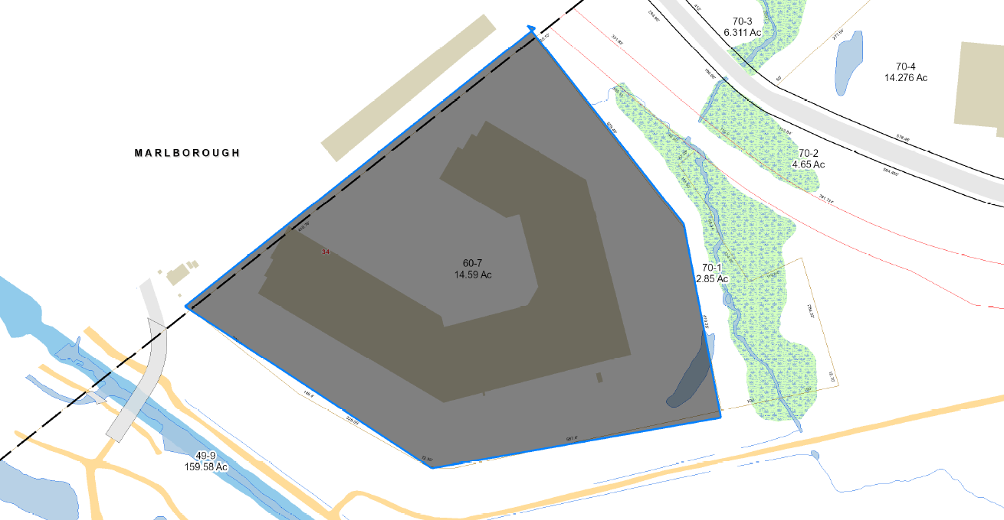
Area #2: 34 St. Martin Street
MAP/LOT | STREET | ACREAGE
60-7 | 34 St. Martin | 14.59
 | Total | 14.59

Slide 16
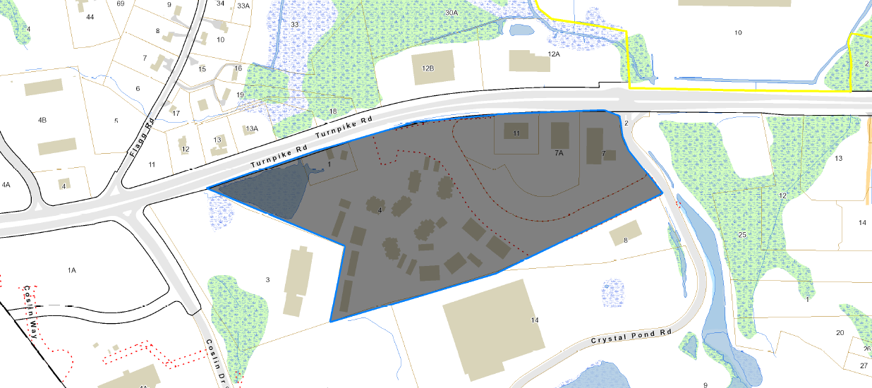
Area #3: Turnpike Road at Madison Place
MAP/LOT | STREET | ACREAGE
25-1 | 334 Turnpike | 0.86
25-4 | 1200 Madison Place | 19.07
26-7 | 300 Turnpike | 4.81
26-7A | 302 Turnpike | 3.76
26-11 | 304 Turnpike | 1.00
 | Total | 29.50

Slide 17
What Happened with the Original Bylaw?
The compliance model was wrong in Area #1; PB withdraws bylaw
In late February/early March, the Planning Board received confirmation from consultants that Area #1 does not meet state requirements
10 acres and 150 potential units
The Planning Board Withdrew the Bylaw from Town Meeting Warrant
The Planning Board contacted the EOHLC and formally requested:
Leniency on the proposed area given the historic designation by the state of MA, water/conservation restrictions, and non-conforming lots within ½ acre of the station
Shifting the measurement of ½ acre to the east
Request to delay requirement for compliance to 12/31/2025 from 12/31/2024

Slide 18
What is Next?
Parallel path progressing a bylaw for 12/31/24 and seek state leniency
Continue to develop a revised submission for Area #1-
Public discussions and a new mapping session planned for June 3rd at the Senior Center
Continue to lobby the state to seek leniency on the Southborough Area #1 requirements for compliance

Slide 19
Still Need Help
Contact your Planner’s Officer and Planning Board
Karina Quinn, Town Planner:
Tquinn@southboroughma.com
Colleen Stansfield, Business administrator
cstansfield@southboroughma.com
Marnie Hoolahan, Planning Board Member
Mhoolahan@southboroughma.com

