Slide 1
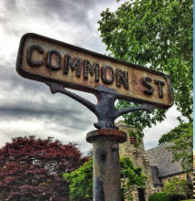

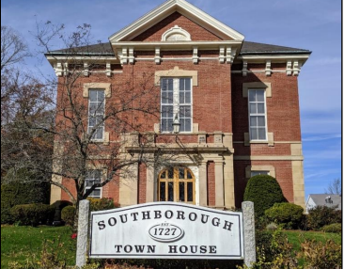
Information Session #1
September 21, 2023
Public Safety Building
32 Cordaville Rd.
Southborough, MA 01772

Slide 2
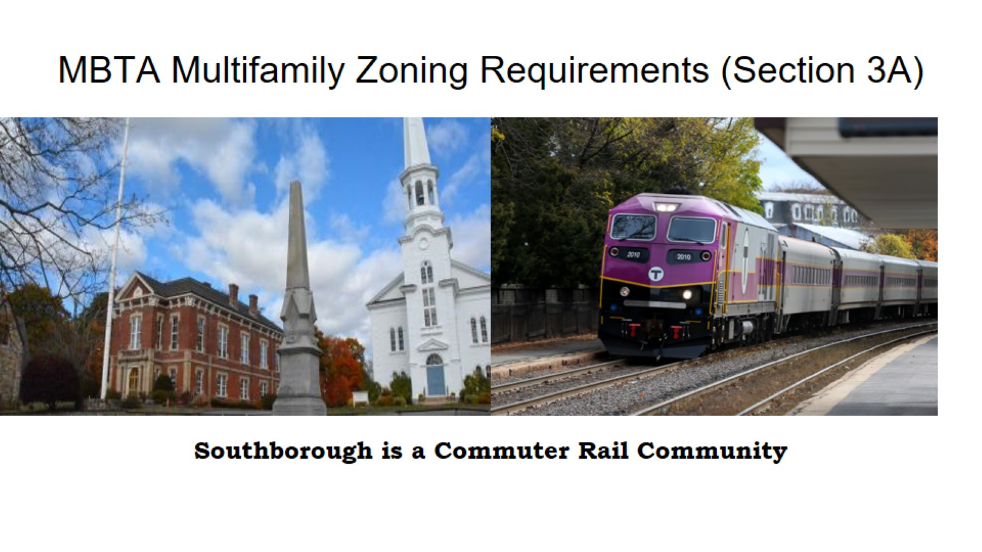

Slide 3
Agenda
What is zoning and why does it matter?
What is Section 3A and why was it passed?
What are the benefits of multifamily housing?
What are the requirements for Southborough?
What could this look like in Southborough
What will this process involve?

Slide 4
What is Zoning?
A code that regulates how we can use land
Includes:
Shape (height and size) of buildings
Distance between buildings and other land uses
What the land can be used for:
Residential – Single or Multifamily
Commercial
Industrial
Open Space
Can also include requirements for things like parking, affordability, and design standards

Slide 5
Why does Zoning matter?
Zoning creates rules for what can be built and where. That determines who can live, work, and play in our communities
If done correctly, it is one of the most powerful tools we have to meet our goals for housing, transportation, climate, and diversity.
However, many Massachusetts communities have stringent and inflexible zoning that has made it illegal or impossible to build anything other than a single-family home.
This pushes out people who can’t afford a single-family home as well as people who want to live in multifamily housing.

Slide 6
What is the impact of restrictive zoning?
High Home Prices
Restrictive zoning creates barriers to addressing our housing shortage, and when there is only so much housing to go around, prices will naturally skyrocket.
According to Redfin, the median price for a single-family home in Southborough is now $1.37 million.
Only 1 in 12 residents in the Boston metro area has the annual income needed to buy a typical home.
Racial Wealth Gap: 70% of White households in greater Boston own their home, compared to 37% of Black households and 31% of Hispanic households
Data from the 2022 Greater Boston Housing Report Card

Slide 7
Why was Section 3A Passed?
Growing a healthy and sustainable regional economy requires providing housing options at a variety of scales and a wide range of price points
Decades of under-producing housing across every municipality has created a serious housing shortage
High home prices are pushing out college graduates, young families, older adults, and even people with moderate incomes
This poses a serious threat to our economy as working families are squeezed out, and many residents are leaving the state

Slide 8
Why was Section 3A Passed? (continued)
We leave our most important housing policy decisions to local governments, but these local governments are not elected to think regionally
Local resistance has prevented 1000s of new homes
State leadership stepped in to course-correct
MBTA Multifamily Zoning Requirements (Section 3A) passed by the State Legislature in 2021

Slide 9
What does Section 3A do?
Requires communities to designate a zoning district in which multifamily housing near transit “as of right”
Impacts all 177 MBTA Communities
Rapid Transit
Commuter Rail
Adjacent Community
Adjacent Small Town
District must allow 15 units/acre by right
Zone must be of “reasonable size”
No age restrictions, must be suitable for families
Certain % must be within ½ mile of transit station, if applicable

Slide 10
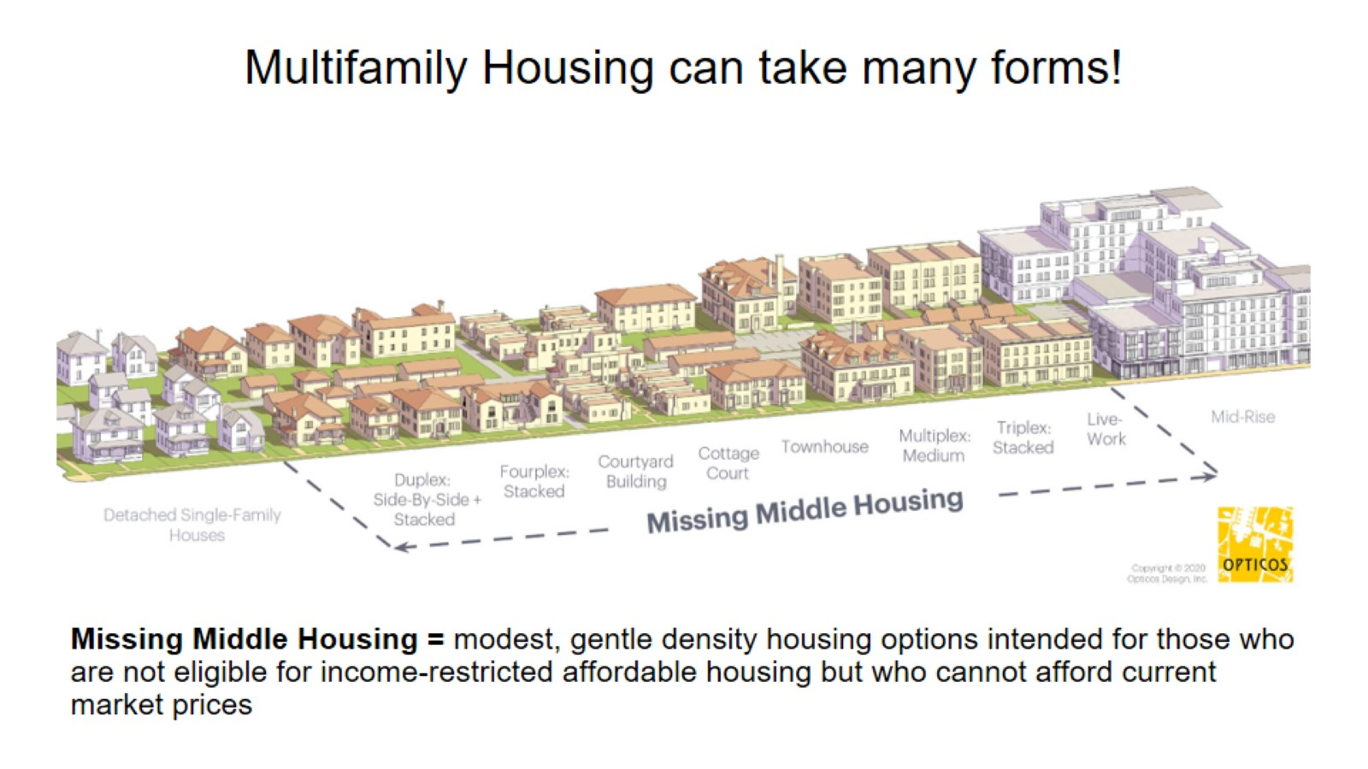

Slide 11
What are the benefits of multifamily housing?
More housing options = more access + greater affordability
Older adults can downsize
College kids can come home and rent their first apartment
Young couples can become homeowners
Low-income families can find housing stability
Middle-income families have greater mobility
Small businesses can retain employees
Grandparents can stay close to their grandchildren
We all benefit!

Slide 12
Why is this good for Southborough?
Southborough has already committed to improving our housing diversity and supporting broader housing goals through the 2019 Housing Production Plan, 2021 Master Plan, and other Town Goals.
Many people may want to live in Southborough, but housing prices are extremely high and many of our homes are single-family only which means...
Seniors wanting to downsize and stay in town have no opportunity to do so
Young couples looking to start a family can’t afford homes in Town
College graduates cannot return to their hometown without having to move back home with (Ugh!) their parents!
Local businesses struggle to find quality employees
We all lose out on new neighbors that the diversity of housing options would bring to our community

Slide 13
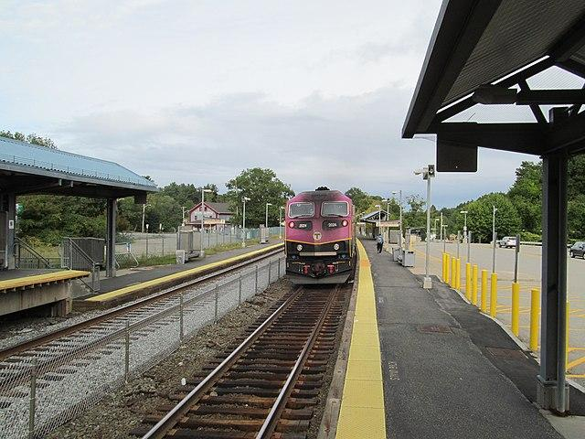
What are the requirements for Southborough?
Transit Type: Commuter Rail
Deadline: December 31st, 2024
Current Housing Units: 3,763
Minimum Land Area: 50 acres
Developable Station Area: 167 acres
% of district to be located in Station Area: 20%
District Capacity: 750

Slide 14
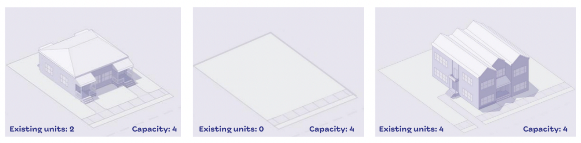
What does zoning capacity mean?
Capacity = what could theoretically be built under the new zoning code if there was nothing currently on the ground
It is NOT a production mandate!

Slide 15
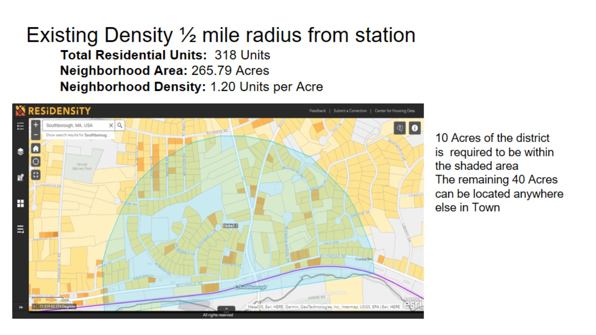

Slide 16
Other Considerations
Land that cannot be included: federal, state, or municipally owned land, certain designated lands like wetlands, flood zones, parks, playgrounds, and conservation land are all excluded.
We can still impose restrictions and incentives in our zoning:
mixed-use
green space
setbacks & height
Lot size
There is no project being proposed
this is mandated zoning for all 177 MBTA Communities and designated adjacent communities.
We cannot require more than 10% affordable units. Up to 20% can be approved by the State if it is shown through an Economic Feasibility Analysis that a higher affordable requirement does not make a project infeasible

Slide 17
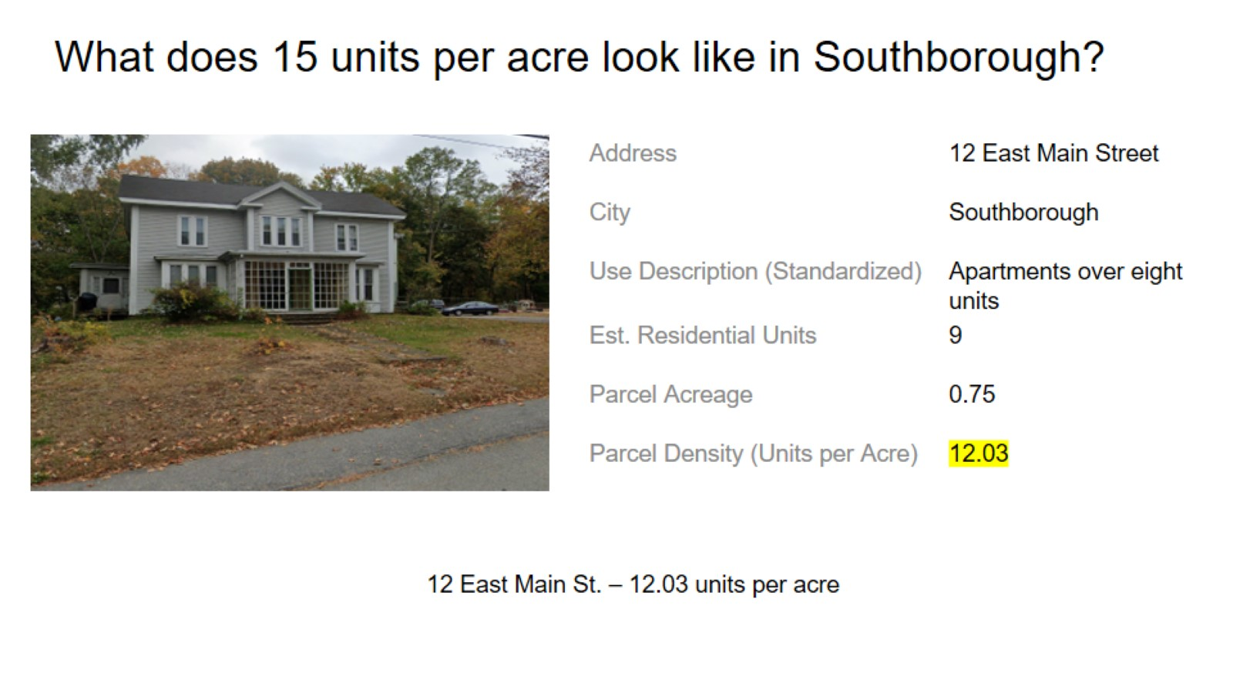

Slide 18
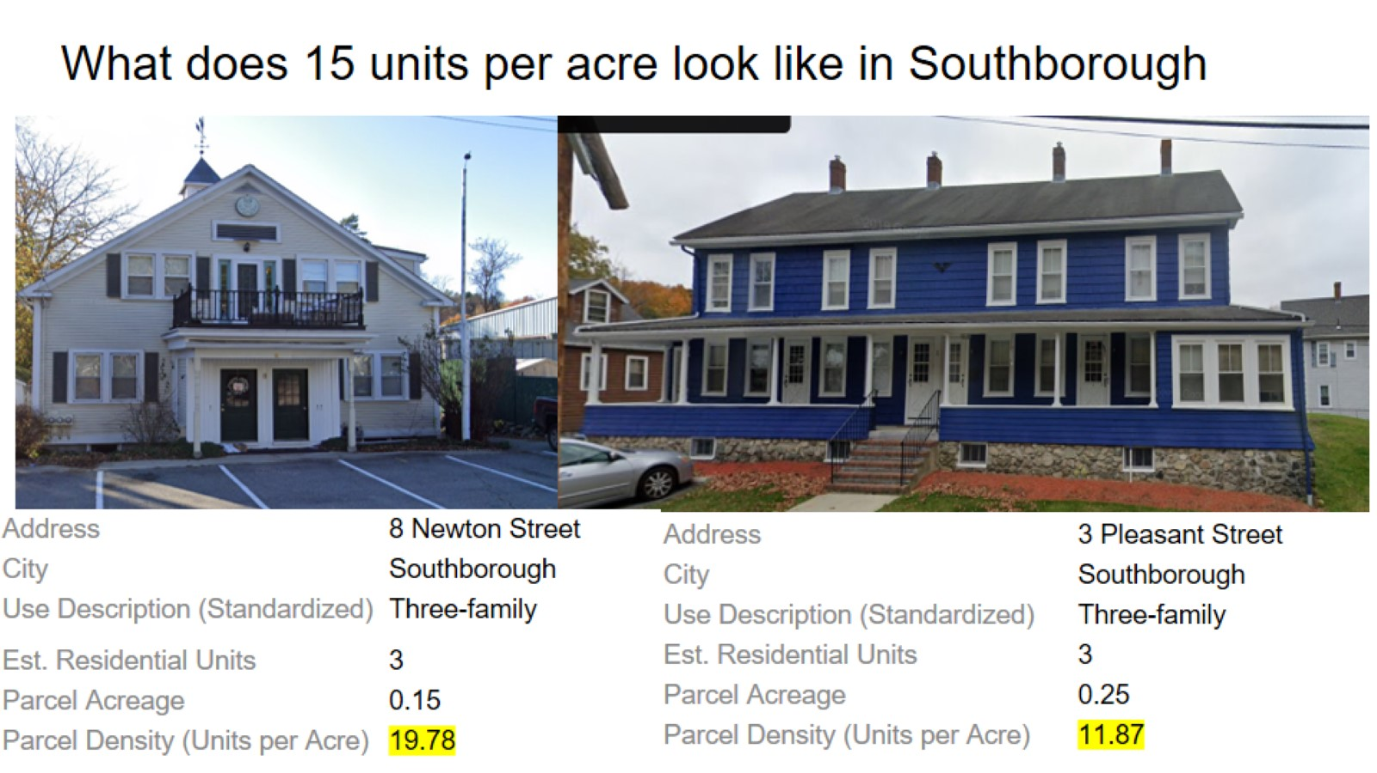

Slide 19
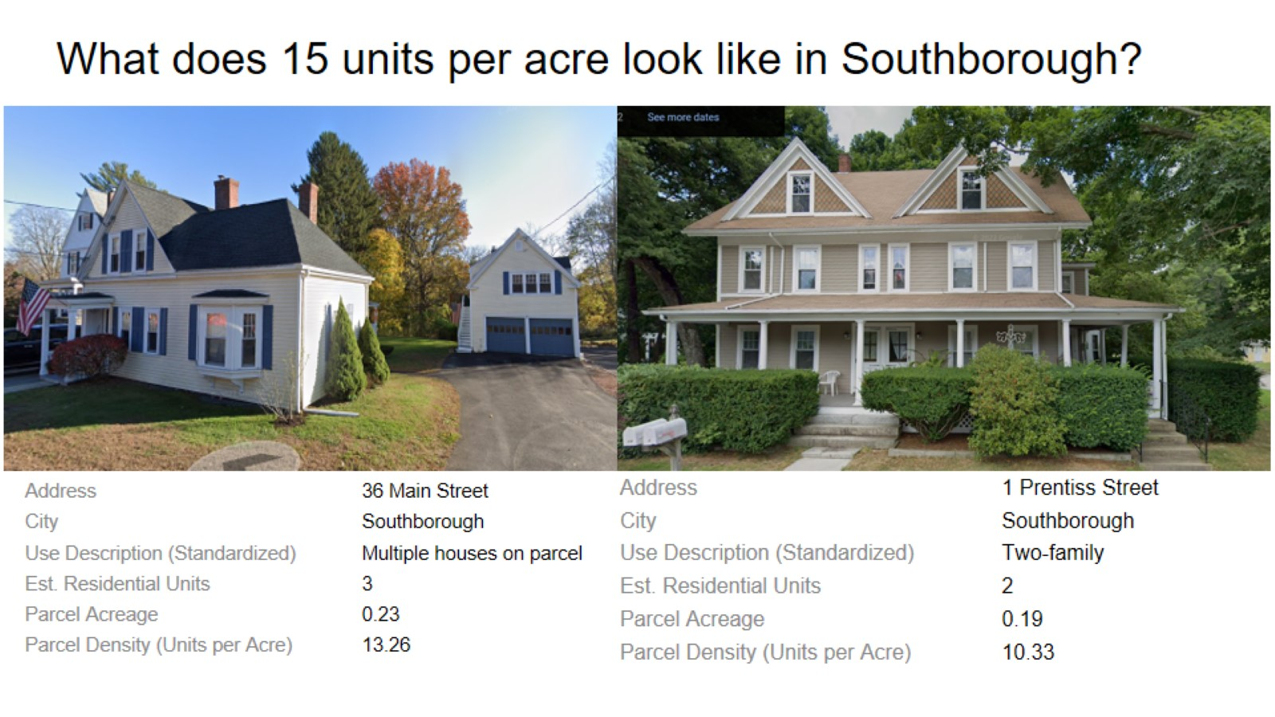

Slide 20
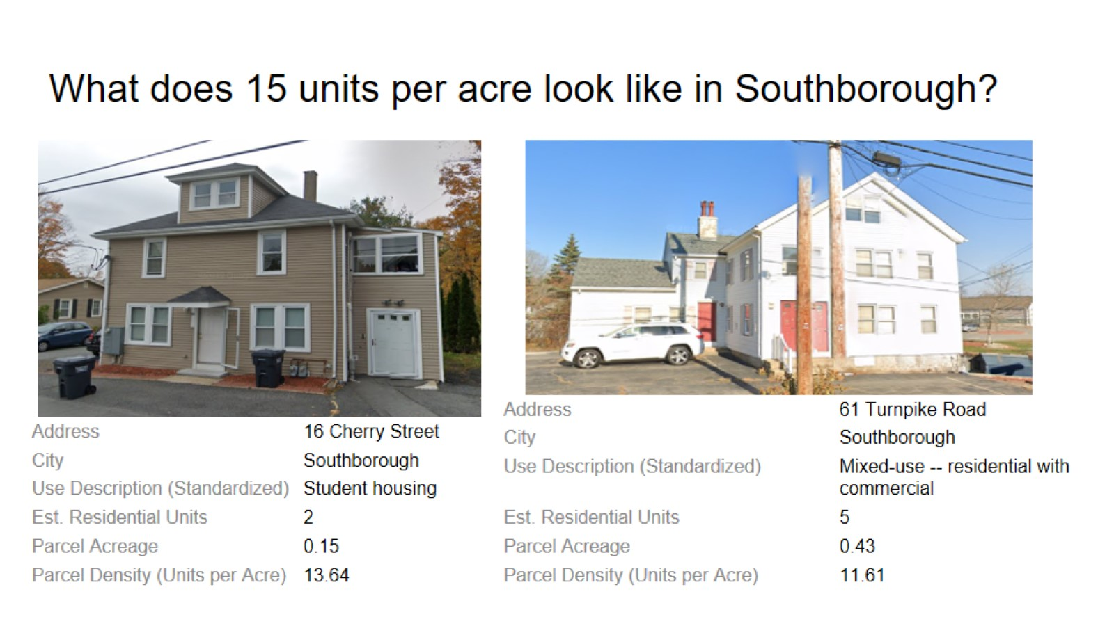

Slide 21
TIMELINE OVERVIEW PLAN PRESENTED
7/7–7/24
1st & 3rd Weeks
Bylaw Development
Initiate formal public hearings
3/1 – mailer on Town Meeting
3/23 – Town Meeting Vote
Plan
Overview of MBTA @ Planning Board
Inform
Information sessions held at Town Hall and Highland St (if available)
Develop
Planning Board public meeting
Communicate
VOTE!
July
Aug.
Sept.
Oct.
Nov.
Dec.
Jan.
Feb.
Mar.
Mid-August
3 Workshops: Dates TBD
Bylaw Development
1st & 3rd Weeks
Inform
Initial postcard mailer
Develop
Planning Board public meeting
Communicate
Information sessions held at Town Hall and Highland St (if available)
Collaborate
Community directive to “map” our district
Focus on abutters, Madison/Deerfoot and Town Meeting participants

Slide 22
SOUTHBOROUGH MBTA COMMUNITY EDUCATION PLAN
Q3: July–September:
Internal Goal: Focus on Communication and Messaging on MBTA Communities
External Goal: Community Communication & Engagement
Explain what MBTA Communities Law is and what it is not
What is in the Town’s control
What is in the State’s control
We want the Town’s collaboration on building what is best for Southborough
Approach: Develop content and materials for town-wide dissemination (Mailers, letters, information sessions)
September: Postcard mailing to Southside of Route 9, Town Meeting participants, and Flagg/Deerfoot Community
September: Letter from Planning Board to direct abutters within ½ mile radius of MBTA

Slide 23
Southborough MBTA Community Education Plan
Q4: October–December:
Internal Goal: Develop the bylaw & prepare Town Warrant Article for Acceptance
External Goal: Community collaboration to shape the bylaw
Approach: Workshops, Planning Board Meetings, and Public Hearings as required
Q1: January–March:
Planning Board: Finalize Bylaw Language & Vote to Support and Recommend Approval at Town Meeting

Slide 24
Next Steps

