Slide 1
MBTA Communities Act Overview and Impact on Southborough
Consolidated by: Southborough Planning Board
MAY 2024

Slide 2
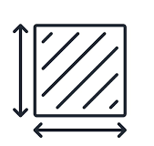




What is the MBTA Communities Act?
State zoning law to boost multi-family housing development near transit stops
In 2020, the Zoning Act was amended by Massachusetts Legislature to promote the production of multifamily housing within walking distance of public transportation to address the severe regional housing shortage
The New Law: “M.G.L. c. 40A § 3A (a)(1) An MBTA Community shall have a zoning ordinance or by-law that provides for at least one district of a reasonable size in which multi-family housing is permitted as of right…”
Commuter rail community — served by the MBTA commuter rail; must rezone to permit a minimum number of multifamily housing units equal to 15 percent of the current housing stock.
50 total acres: 10 acres within
½ mile of MBTA station
Walking distance to public transportation, bikeways, bus stops
Suitable for families with children
(no bedroom or age restrictions)
Zoning must allow a minimum gross density of 15 units per acre
Zoning permit process cannot
be discretionary
For additional information visit: https://www.mass.gov/info-details/multi-family-zoning-requirement-for-mbta-communities#complying-with-section-3a-guidelines-

Slide 3
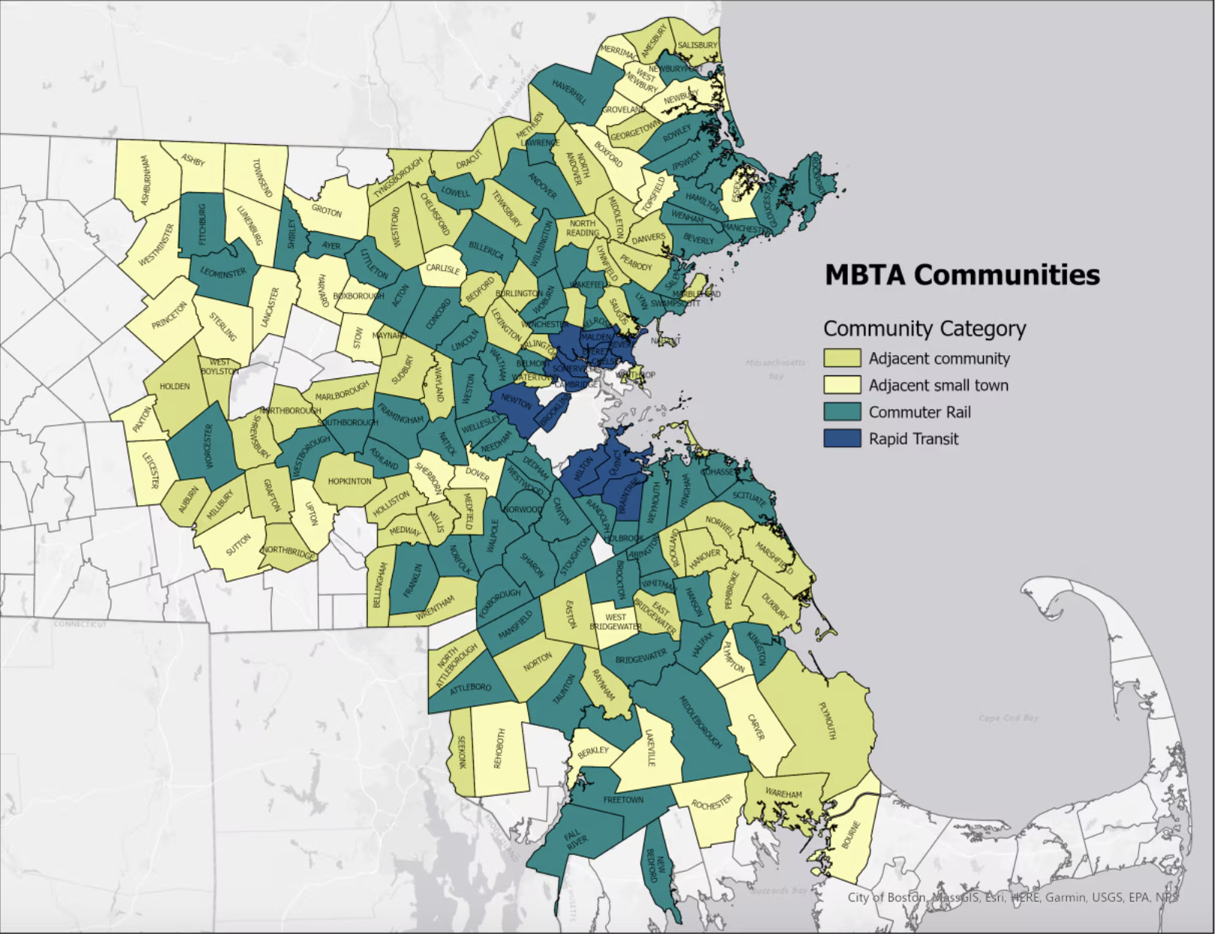
What are the MBTA Communities?
177 communities in totality; with four (4) types of communities designated
Rapid Transit Communities – Fourteen (14) Greater Boston cities and towns, that initially hosted MBTA service, must submit their district compliance applications by December 31, 2023.
Community Rail Communities – Fifty-one (51) communities that also host MBTA service but joined later) must submit their district compliance application by December 31, 2024.
Adjacent Communities – Must submit their district compliance application by December 31, 2024
Adjacent Small Towns – Must submit their district compliance application by December 31, 2025.

Slide 4
What the Act Means to Southborough
As a commuter rail community, Southborough has a moderate level of obligation
“The new policy is not a construction mandate,
but a mandate for zoning allowances that can offer expanded opportunities to build homes. No municipality would be forced to build units on any specific timeline —
or even build them at all.”
– Boston Globe
50
Acres
10 Acres within 1/2 mile of the MBTA station
25 Acres must be contiguous
15 Acres in minimum of 3, 5 Acre areas
750 Units
Rezone to permit 750* multifamily
housing units
20% required near transit stations
Source: https://www.bostonglobe.com/2022/07/13/metro/is-states-multi-family-zoning-requirement-mbta-communities-good-policy/?p1=BGSearch_Advanced_Results
* This figure represents not how much new multifamily housing is likely to be built, but how many total units must be possible in the rezoned areas.
Notes:
Commuter rail community — served by the MBTA commuter rail; must rezone to permit a minimum number of multifamily housing units equal to 15 percent of the current housing stock. Deadline for rezoning is the end of 2024.
Population (2020): 10,450
Housing units (2020): 3,763
Owner-occupied percentage: 90.7%
Median household income: $156,845

Slide 5
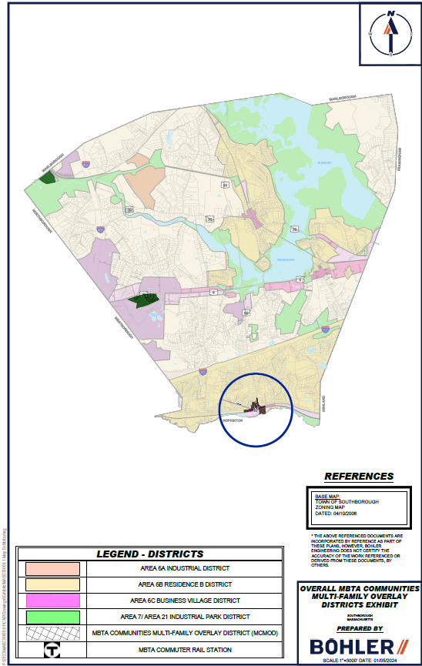
ORIGINAL Proposed MBTA Overlay Bylaw Intended For Town Vote in March 2024
Consultants confirmed recommended proposal meets State Compliance Model
  933 total units of the required 750
  55.0 acres of the required 50
  11.3 acres within the station area of the required 10
The Consultants notified the Board in late February that they misinterpreted the results of the State Compliance Model and Area #1 did not comply.
The Planning Board Withdrew the Bylaw from Town Meeting Warrant
The Planning Board readjusted and decided to move forward on two tracks.
  Contacted the EOHLC and formally requested flexibility in compliance requirements.
  Remap Area #1 to gain compliance
Bring Bylaw to Special Fall Town Meeting
AREA #3: 34 St. Martin
AREA #2: Madison Place
AREA #1: MBTA Station

Slide 6
Southborough MBTA Timeline May-Dec 2024
Mon 5/20
Mon 6/17
Mon 7/8
PB Meeting
Discussion
PB Meeting Finalize Area #1 for Bylaw
Public
Hearing Notice advertisement #1
Wed 6/3
Tue 12/31
Area #1
(MBTA Station)
New Map Session (Sr. Ctr.)
Wed 6/26
Mon 7/15
State MBTA
Communities
Bylaw Approval
Deadline
Submit Public Hearing Notice to Newspaper
Public
Hearing Notice advertisement #2
Mar
May
Jun
Jul
Aug
Sep
Dec
Apr
Oct
Nov
Fri 6/21
Mon 7/22
Mon 9/23
PB Rewrite Bylaw with revised Area #1
PB MBTA Communities Public Hearings
Open
Special Town Meeting
PB Submission to State: Pre-Qualification Process

Slide 7
THANK YOU !!

